Slide 1
GE IV: ELEMENTS OF ANALYSIS B.A(HONS.) ECONOMICS SEMESTER IV
SUPPLEMENTARY STUDY MATERIAL
UNIT III: POWER SERIES THEOREMS

Slide 2
Some Important Results on Exponential, Sine & Cosine Functions (Proofs Using Power Series)

Slide 6
Convergence of Taylor’s Series: (Taylor’s Theorem, Lagrange form of Remainder & its Applications)

Slide 10
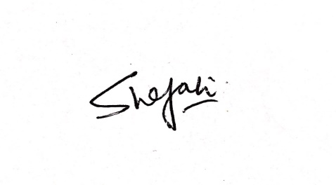
For any additional information or discussion, students may feel free to contact the undersigned.
Dr. Shefali Kapoor Assistant Professor Department Of Mathematics SRCC

